Slide 1
Chapter 5
Application and Language Security

Slide 2
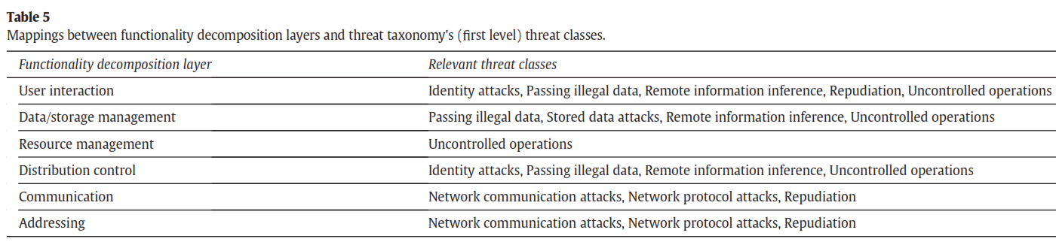
Types of threats in all architectural levels [Uzu15]

Slide 3
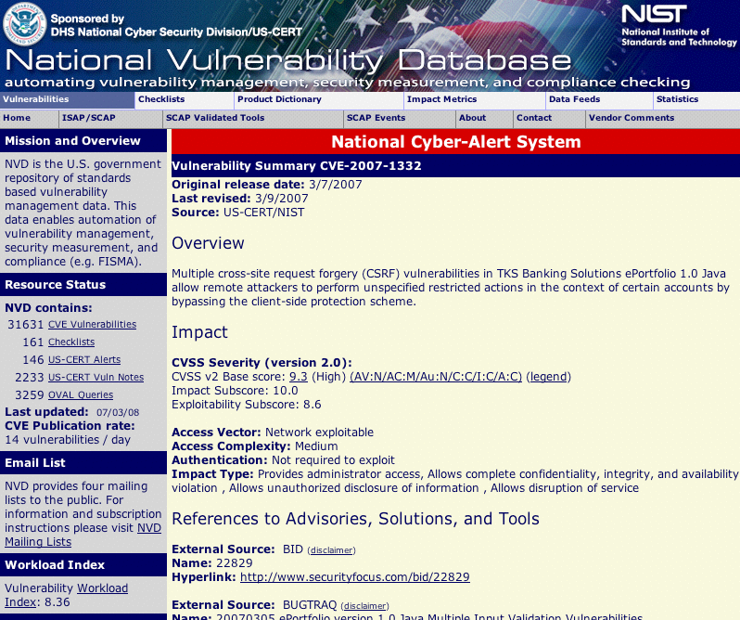

Slide 4
Application threats
Programs are the means by which computers are controlled. As such, malicious programs can be used to control computers in ways not intended by the owners of the computers.
In addition—since many applications are complex—they often have flaws that may be exploited by intruders. This chapter considers the effect of application software on security
A variety of attacks occur through the execution of applications due to the characteristics of the languages used. The most common problem is buffer overflow. Attacks from downloaded contents were initially serious but have been controlled with recent advances. Other application-related attacks include misuse of pointers, misuse of data types (e.g., execution of data), and bypassing entry points that have access controls. Large applications may use components, which brings new security problems.

Slide 5
Open Web Application Security Project (OWASP)
The OWASP Foundation came online on December 1st 2001 it was established as a not-for-profit charitable organization in the United States on April 21, 2004 to ensure the ongoing availability and support for our work at OWASP.
OWASP is an international organization and the OWASP Foundation supports OWASP efforts around the world. OWASP is an open community dedicated to enabling organizations to conceive, develop, acquire, operate, and maintain applications that can be trusted. All of the OWASP tools, documents, forums, and chapters are free and open to anyone interested in improving application security. We advocate approaching application security as a people, process, and technology problem because the most effective approaches to application security include improvements in all of these areas. We can be found at www.owasp.org.
OWASP is a new kind of organization. Our freedom from commercial pressures allows us to provide unbiased, practical, cost-effective information about application security. OWASP is not affiliated with any technology company, although we support the informed use of commercial security technology. Similar to many open-source software projects, OWASP produces many types of materials in a collaborative and open way

Slide 6
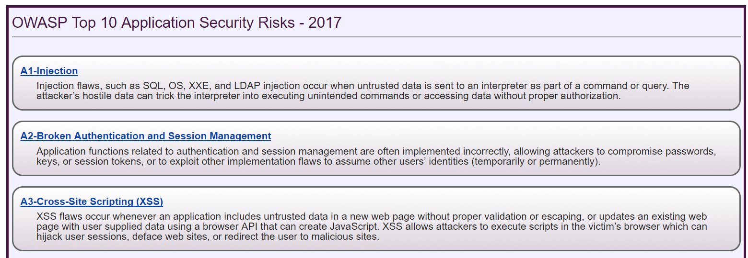

Slide 7
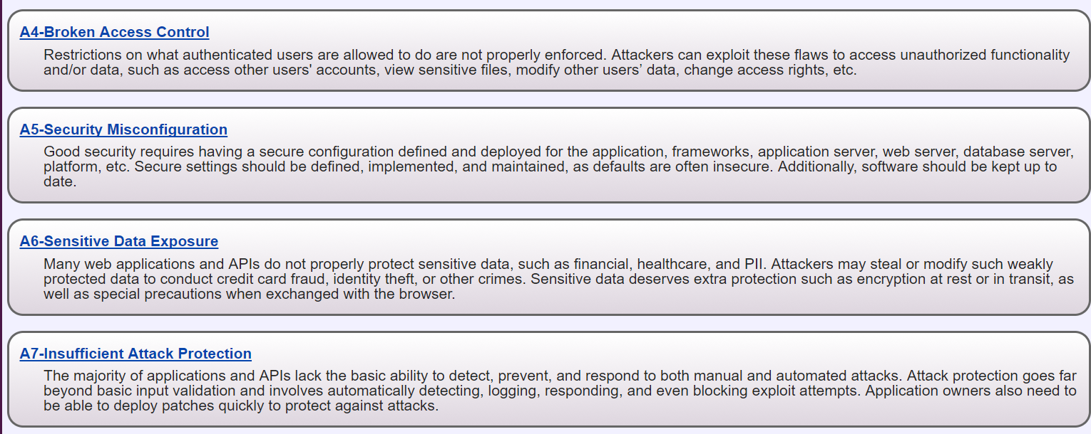

Slide 8
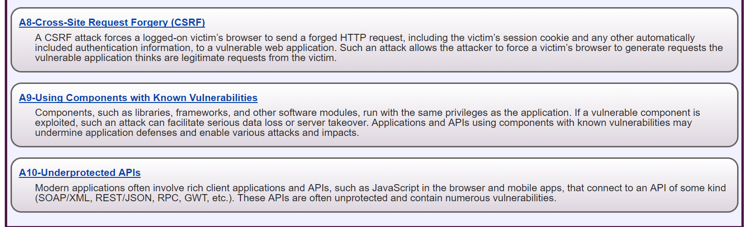

Slide 9
Confusions
OWASP and NVD confuse vulnerabilities with threats
When discussing a threat one should consider the vulnerabilities that make possible for the threat to launch an attack but often more important than fixing a vulnerability (usually hard to do) is to stop or mitigate the attack by interrupting its sequence of steps.
That is the idea of the misuse patterns, that describe how an attack is performed

Slide 10
Misuse patterns
A misuse pattern describes how an attack intending a misuse of information is performed from the point of view of the attacker. It defines the environment where the attack is performed, the sequence of steps to perform the attack, countermeasures to stop it, and provides forensic information in order to trace the attack once it happens
The pattern tries to show how the attacker works (modus operandi) so we can apply defenses to stop it
The objects in the sequence diagram represent architectural units of the target system
Misuse patterns are described by templates with sections indicating the vulnerabilities they exploit, the advantages for the attacker (goals), the steps of the attack, its consequences, and incidents.

Slide 11
Worm misuse pattern
Intent
Propagate to as many places as possible (or to specific systems), usually indicating its presence, and maybe performing some damage.
Context
Sites connected through the Internet or another type of network. The Internet provides a variety of services such as email, file transfer, and web services (Figure 1). Any of these services can be used for propagation. Both fixed and wireless networks can be used by the worm. Portable storage devices such as memory sticks can also propagate worms.
Problem
A worm tries to take advantage of any input to invade a system. Users might open attachments carrying worms and some ports of a system may be unprotected or have vulnerabilities; all of these give the worm a chance to invade. Mail systems and file transfer systems for example, include lists of addresses which can be used by the worm to find places where to propagate. Many systems do not control access to their system directories and do not restrict Internet traffic, which facilitates a worm invasion.

Slide 12
Forces I
Objectives. Its objectives may be political, monetary, or vandalism. A political worm typically tries to produce damage to an antagonist; a monetary worm tries to reach many places to collect information or drop spyware; a vandal worm tries to destroy or damage information.
Reach. Try to reach as many places as possible or to specific sites. For most worms, reaching many places is a basic objective.
Presence manifestation. Try to show its presence in the system so victims know about it. Exceptions to this are cases where the objective is to drop spyware.
Credit. To embed an identification or mark so that the creator can take credit for it.
Misuse. Perform some destruction and/or other misuses (confidentiality, integrity, or availability). The misuse may be delayed (time bomb).

Slide 13
Forces II
Obfuscation. Try to hide its structure to make harder its detection and removal.
Collateral damage. In addition to specific misuses, the worm may require costly operations for its removal, stopping or disrupting business activities. Its propagation may affect the normal traffic in the network.
Latency. Its propagation must be as fast as possible to avoid detection and countermeasures.
Activation. This can be done by enticing offers which may tempt users to open email attachments or download procedures (social engineering). Other possibilities are invading through unprotected ports or taking advantage of vulnerabilities

Slide 14
Solution
Attach a core portion of the worm to email messages or to files. When the user opens the message attachments or executes the file the core of the worm starts executing. Alternatively, invade through an unprotected or flawed port. Download remaining portions from complementary network sites. Use some procedure to hide the structure of the worm. Perform its mission and propagate. Figure 2 shows the propagation of a typical worm; speed comes from a tree-like propagation.
Structure
Figure 3 shows a class diagram of the units involved. Class Node represents any node in the network, defined by its address (URL in the Internet). Any node can be the origin of a worm and any node can be its target (and be invaded). Some nodes are complementary sites from which commands or other parts of the worm may be retrieved. Class Worm represents the worm itself, including procedures for initial setup, to bring complementary parts, to hide the worm, to perform its mission, and to propagate.

Slide 15
Worm propagation

Slide 16
Class diagram

Slide 17
Worm propagation

Slide 18
Variants
A passive worm requires a user to activate an executable program and it usually propagates through email. Melissa, ILOVEYOU, Anna Kournikova, and Bagle are examples of this type.
An active worm takes advantage of some system flaw to provoke a buffer overflow or another attack to get in through some port. It may scan looking for unprotected ports. Code Red is an active worm. Storm can be active or passive [Smi08].
A virus attaches itself to some program (infects an executable file) and when the user executes this program it gets activated. Jerusalem, Christmas, and Chernobyl are examples of viruses.
Some worms have several versions with different purposes; for example, Storm has variants that perform different types of misuses, including targeted spam and DDoS attacks [Smi08].
Some worms are multimode (multivector) worms, which can use a variety of ways to invade their targets; for example the Storm virus infects computers using multiple payloads [Smi08].

Slide 19
Known uses (incidents)
ILOVEYOU [ILO, wor09]. This was an email attachment worm that appeared in 2000. It relied in social engineering to entice users to open the attachment. It also used specific weaknesses of Microsoft Windows. It propagated using the addresses in the address book of the mail system.
Bagle. It was a mass-mailing worm written in assembly language [bag] and affecting all versions of Windows. After activation, it copies itself to the Windows system directory and downloads a SMTP engine to mail its core to other nodes as an attachment (see the Implementation section for its typical behavior).
Code Red [Ber01]. It appeared in July of 2001. It propagated through port 80, indicated its presence by defacing web pages, propagated using a random IP address generator, and later would activate a denial of service attack from infected sites.
Nimda [nim]. Nimda is a multivector worm that can use several ways to propagate: email, visiting an infected site, seeking out vulnerable servers to upload files, or through the network.
Slapper [Arc03]. Can launch denial of service attacks. Propagates finding addresses in files. The nodes invaded by the worm communicate using a P2P protocol to collaborate in their misuses.

Slide 20
Countermeasures
Policy about attachments: Users should be trained to recognize trustable attachments and they should be forbidden to open unknown or suspicious attachments.
Need-to-know policy to define access by system processes to resources. For example, address lists should use authorization to control access to their contents.
Control of network communications: Connections should be established with only trusted addresses (control through the firewalls). This policy may avoid downloads from complementary sites.
Intrusion detection: An IDS can detect some attacks in real time and alert the firewall to stop it.
Use of antivirus software: Can help detect and clean worms after the fact
Backups. Checkpointing files and keeping backup images of them is a fundamental precaution against data destruction or unauthorized modification.
Specialized hardware. Process communication controls in the operating system can be enforced through specialized hardware [Shi00]. It is possible to define partitions in the operating system that can be enforced by hardware and will prevent a worm from performing its actions.

Slide 21
Structure of a virus (code level)
Could be added to the misuse pattern to describe one of its variants
Main procedure to call the other procedures
Find an executable file to infect
A flag to avoid multiple infections of the same file
A function to check if a file is already infected
If infect condition is true then infect
Infect: make a copy of the worm code and prepend it to the file

Slide 22
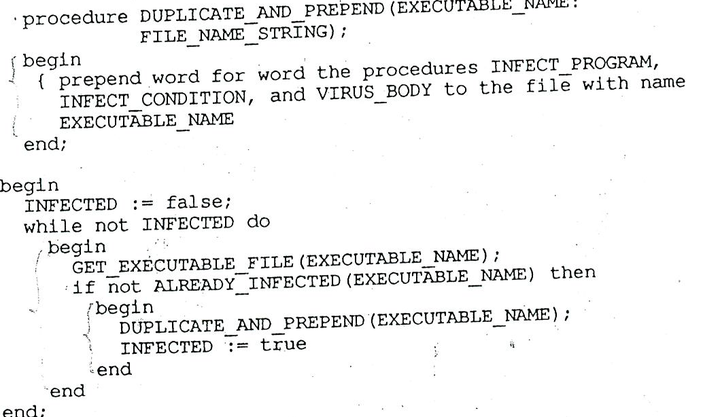

Slide 24
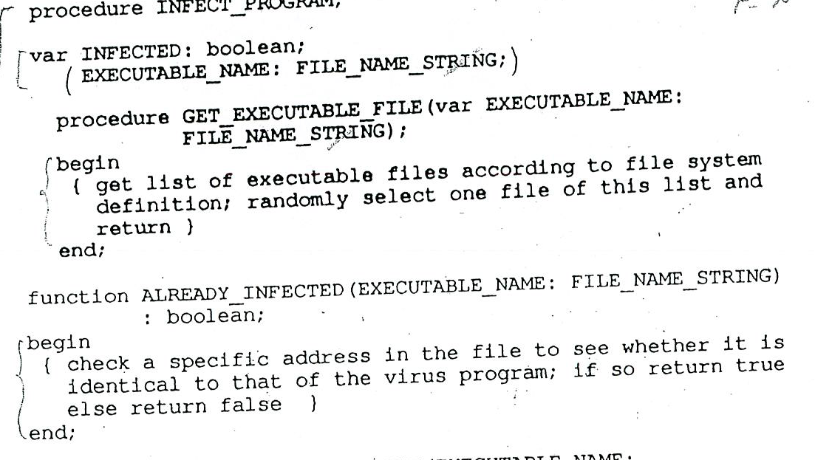

Slide 25
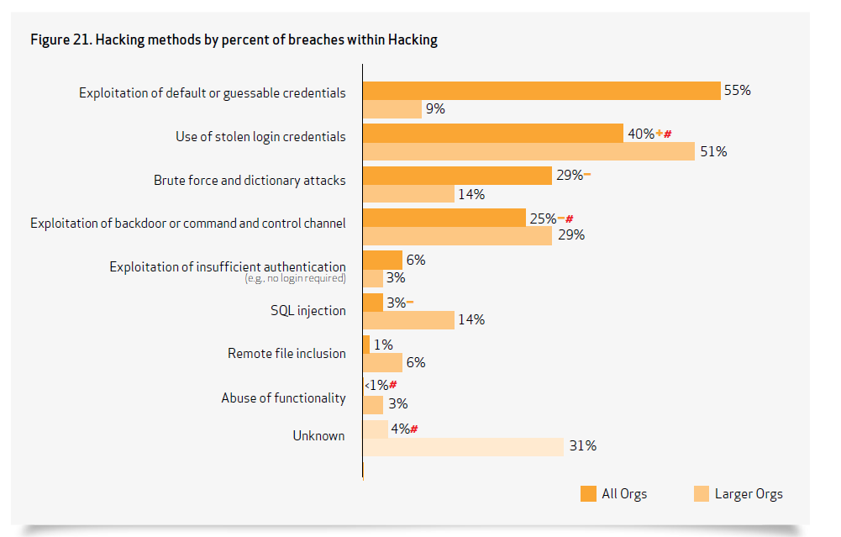

Slide 26
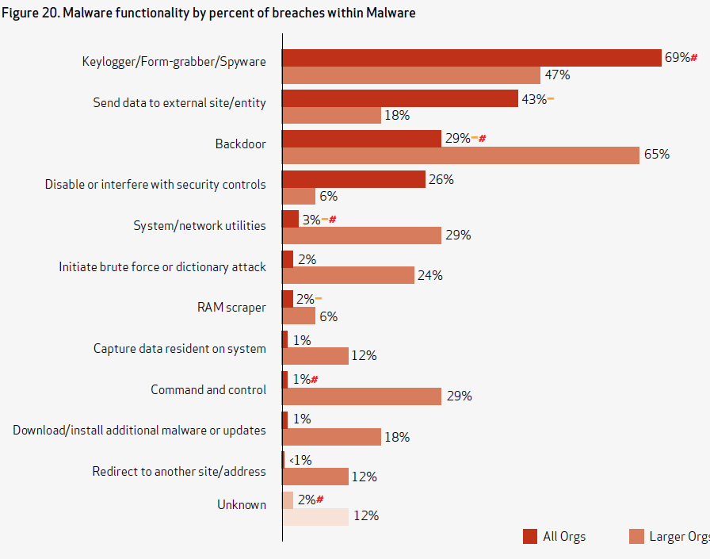

Slide 27
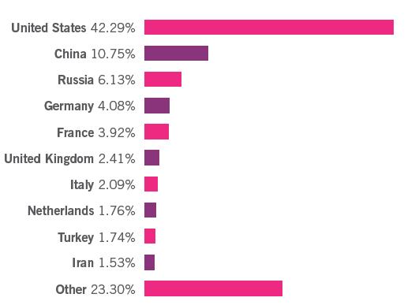
Top malware hosting countries

Slide 28
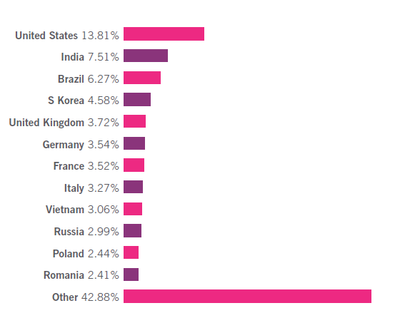
Top spam relaying countries

Slide 29
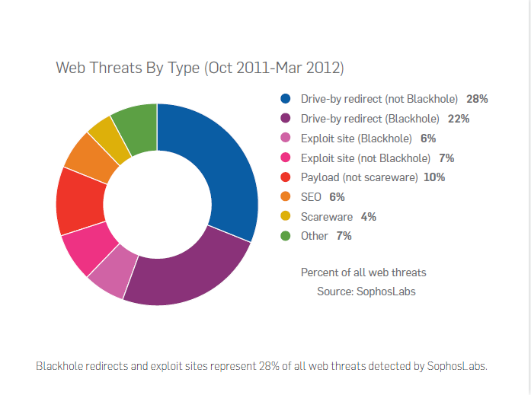

Slide 30
Blackhole
It is an exploit kit, a tool from the attacker to get their software installed in a PC
Created by specialists who sell them to attackers, a service for hackers
According to Sophos between Oct. 2011 and March 2012 30% of the detected threats used Blackholes
Used to send users to an exploit site (landing page): compromised web pages, spam messages, or other

Slide 31
How they infect users
Compromised webpages: The attackers compromise legitimate websites or servers to serve malicious code. When users browse these pages, the malicious code loads content from the exploit site. Often the injected redirects do not link directly to the Blackhole exploit site. Instead they reference a remote server that bounces the request to an exploit site. This approach allows exploit writer to sell user traffic as a commodity. Links to these pages can also spread by other methods such as enticing messages on Twitter. For example links spread via Twitter point to Russian webpages that attempt to infect a Windows PC
Spam messages: Spam continues to be a useful tool for attackers to trick
users. Attackers may send spam including a URL link within the email
message, which loads JavaScript content to redirect to the Blackhole site
or an email message containing a HTML attachment.

Slide 32
Infection II
Landing page: Whatever method is used to control user web traffic, the result is the same: the user’s browser loads code served up from the “landing page” of the exploit kit. The landing page:
Credits page requests to specific individuals or groups responsible for redirecting the victim for payment purposes
Fingerprints the machine to identify OS, browser and browser version, Adobe Flash, Adobe Reader versions, Java version
Loads the relevant exploit components (PDF, Flash, Java—the file types used by Blackhole)

Slide 33
Protection
Spam filters: intercept the initial email contact using a spam filter with content scanning, which blocks the email by detecting either the obfuscated JavaScript content or its botnet-based origination.
Web filters: A web filter can block the web components of an attack, either at the network or endpoint level, by actively scanning content to identify the probing JavaScript.
Patching: Patching the operating systems and applications provides an additional defense. While patching cannot prevent zero-day vulnerabilities, Blackhole and other similar kits mainly target application vulnerabilities in Flash, Adobe Reader and Java. You can protect these applications by turning on functionality that either automatically updates the software or reminds you when updates become available.

Slide 34
Zero Access
A family of rootkits and backdoors used to install and conceal other malware, commonly for redirecting a user’s web traffic. It uses rootkit techniques to hide from security software while allowing remote attackers to control infected computers.
The concealment of a rootkit makes it more likely that an attack will remain unnoticed, allowing attackers to steal more information and take advantage of a compromised network for a long time.

Slide 35
Defenses
Anti-rootkit tools: For the true rootkit versions, an anti-rootkit tool or an anti-malware scanner with anti-rootkit capabilities is the best defense. Typically these will find the modifications in the operating system kernel and proceed to clean up from there. Due to the nature of cleaning an infection from kernel memory, a system restart can be required.
Logs: Monitoring security console or management logs for errors can tip you off to a network incursion. Remember that some versions of ZeroAccess, and other malware, will attempt to disable installed security products. So a sudden rash of failure reports could be related to an infection.
Firewalls: Perimeter or client firewalls can disrupt the peer-to-peer communications of a botnet such as ZeroAccess, although it gets some information via HTTP, which is unlikely to be blocked. Much of the P2P communication is done at high port numbers not used by common services.

Slide 36
Nearly Every U.S. Arms Program Found Vulnerable to Cyber Attacks http://www.nytimes.com/reuters/2015/01/20/technology/20reuters-cybersecurity-pentagon.html?_r=0
WASHINGTON — Nearly every U.S. weapons program tested in fiscal 2014 showed "significant vulnerabilities" to cyber attacks, including misconfigured, unpatched and outdated software, the Pentagon's chief weapons tester said in his annual report released Tuesday.
Michael Gilmore, director of operational test and evaluation (DOT&E), said program managers had worked to resolve problems discovered in previous years and security was improving, but this year's testing had revealed new vulnerabilities.
The report comes amid growing attention to cybersecurity within the U.S. government, and was released days after fresh documents leaked by former U.S. intelligence contractor Edward Snowden said China had stolen "many terabytes" of data about the Lockheed Martin Corp F-35 fighter jet.

Slide 37
Defenses: SIEM
Security information and event management (SIEM) software products and services combine security information management (SIM) and security event management (SEM). They provide real-time analysis of security alerts generated by network hardware and applications.
Vendors sell SIEM as software, as appliances or as managed services; these products are also used to log security data and generate reports for compliance purposes.
The product capabilities include gathering, analyzing and presenting information from network and security devices, identity and access-management applications, vulnerability management and policy-compliance tools, operating-system, database and application logs, external threat data

Slide 38
Gartner Magic Quadrant
The security information and event management (SIEM) market is defined by the customer's need to analyze event data in real time for the early detection of targeted attacks and data breaches, and to collect, store, investigate and report on log data for incident response, forensics and regulatory compliance. The vendors included in our Magic Quadrant analysis have products designed for this purpose, and they actively market and sell these technologies to the security buying center.
SIEM technology aggregates event data produced by security devices, network infrastructure, systems and applications. The primary data source is log data, but SIEM technology can also process other forms of data, such as NetFlow and network packets. Event data is combined with contextual information about users, assets, threats and vulnerabilities. The data is normalized, so that events, data and contextual information from disparate sources can be correlated and analyzed for specific purposes, such as network security event monitoring, user activity monitoring and compliance reporting. The technology provides real-time correlation of events for security monitoring, query and analytics for historical analysis and other support for incident investigation and compliance reporting.

Slide 39
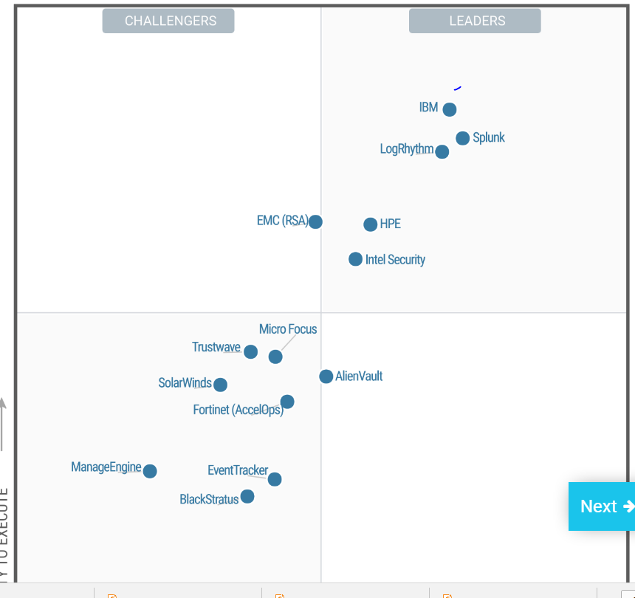

Slide 40
Threat/security intelligence
Information used to automatically detect threats and react to them.
This information includes IP addresses, domain names, DNS servers, URLs, file names, network signatures, attack patterns, actor profiles,…
This information must be analyzed and combined with information about attacker’s tools, methods, and infrastructure, honeypots,…

Slide 41
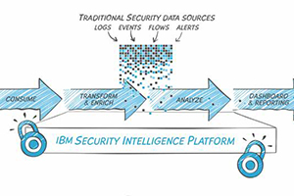
IBM Security Intelligence with Big Data http://www-03.ibm.com/security/solution/intelligence-big-data/

Slide 42
IBM II
IBM QRadar Security Intelligence Platform and IBM Big Data Platform – provide a comprehensive, integrated approach that combines real-time correlation for continuous insight, custom analytics across massive structured and unstructured data, and forensic capabilities for irrefutable evidence. The combination can help you address advanced persistent threats, fraud and insider threats.
The IBM solution is designed to answer questions you could never ask before, by widening the scope and scale of investigation. You can now analyze a greater variety of data – such as DNS transactions, emails, documents, social media data, full packet capture data and business process data – over years of activity. By analyzing structured, enriched security data alongside unstructured data from across the enterprise, the IBM solution helps find malicious activity hidden deep in the masses of an organization’s data.

Slide 43
Splunk
Splunk is an American corporation based in San Francisco, CA, that produces software for searching, monitoring, and analyzing big data, via a Web-style interface.
Splunk products capture, index, and correlate real-time data in a searchable repository from which it can generate graphs, reports, alerts, dashboards, and visualizations
Objective is identifying data patterns, providing metrics, diagnosing problems, and providing intelligence for business operations. Splunk is a horizontal technology used for application management, security and compliance, as well as business and Web analytics.
One of my ex-students: Haiyan Song (MS 1988)

Slide 44
Typical application threats
Identity attacks
Viruses and worms
Buffer overflow
Exceeding array bounds
Misuse of pointers
Downloaded active contents

Slide 45
An identity attack in an old assignment
There was a large data breach in the IRS recently (2015). Using information available in the Internet draw a sequence diagram showing how this breach happened.
Hackers used the "Get Transcript" program, which allows you to check your tax history online. The IRS began the online program in 2014, allowing taxpayers to request their tax history over the Internet, in addition to the post office. Hackers used stolen or guessed credentials to get many transcripts and filed fake tax declarations requesting money back for excess of deductions.
Indicate what policies and mechanisms would have stopped the attack. Give references to indicate the sources of your description.

Slide 46
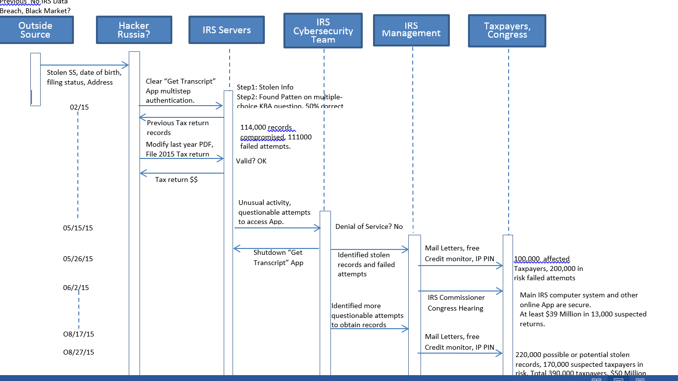

Slide 47
Vulnerabilities, misuses and defenses
More than 700,000 social security numbers and other sensitive information may have been stolen.
To access their past returns taxpayers authenticate themselves to the IRS. Passwords and secret questions are easy to get or to guess. Educate taxpayers.
The IRS said hackers used personal information gathered from other online sources - like bank accounts - to answer personal identity questions on the "Get Transcript" forms. One possible culprit is the IRS-approved tax preparers. According to an audit conducted by the non-profit online trust alliance, six out of 13 IRS-approved companies failed at providing adequate security to customers.
Use better authentication, i.e. two or multifactor authentication with different media. Hackers cannot get individuals’ returns if they fail this step.

Slide 48
Some Multi-factor authentications are weak
The IRS incident is but the latest example of a hack that could have been prevented with two-factor authentication (TFA): combining something you know (a password or PIN) with something you have (a phone or security token).
Most hacks have involved guessing weak passwords using a dictionary attack, statistical analysis, or lists of popular (and weak) passwords.
But the IRS attack exposed another flaw in common authentication schemes, reliance on personally identifiable information for access or password recovery.
The IRS attack combined a step using Name,SSN, DoB, and Filing Status with another step of personal questions selected by the taxpayers.

Slide 49
Secret questions
Although the IRS attackers appear to have gained IDs in other ways, such as purchasing a Fullz Dump, researchers atGoogle GOOGL +0.75% have discovered how easily password recovery questions can be guessed. They found answers ”contain commonly known or publicly available information, or are in a small set of possible answers for cultural reasons,” allowing the team to correctly guess challenge questions with surprising frequency. For example, there’s a one-out-of-five chance of matching an English-speaker’s favorite food (pizza) or a 12% chance of getting a Korean’s place of birth on the first try (the full research report can be found here).
Even when users attempt to spoof identity thieves it backfires. Google “found that 37% of people intentionally provide false answers to their questions thinking this will make them harder to guess. However, this ends up backfiring because people choose the same (false) answers, and actually increase the likelihood that an attacker can break in.”

Slide 50
References
http://qz.com/445233/inside-the-irss-massive-data-breach/
http://www.nextgov.com/cybersecurity/2015/08/inside-massive-irs-data-breach/119666/
http://www.irs.gov/uac/Newsroom/IRS-Statement-on-the-Get-Transcript-Application
http://www.forbes.com/sites/kurtmarko/2015/05/27/irs-hack_fido-leadership/
http://blogs.wsj.com/briefly/2015/05/27/5-questions-about-the-irs-data-breach/
http://www.irs.gov/uac/Newsroom/Get-Transcript-Application-Questions-and-Answers
http://www.irs.gov/uac/Newsroom/IRS-Statement-on-the-Get-Transcript-Application
http://www.irs.gov/uac/Newsroom/Additional-IRS-Statement-on-the-Get-Transcript-Incident
http://www.irs.gov/uac/Written-Testimony-of-Commissioner-Koskinen-on-Unauthorized-Attempts-to-Access-Taxpayer-Data-before-Senate-Finance-Committee
https://nakedsecurity.sophos.com/2015/08/18/irs-estimate-of-stolen-tax-records-balloons-to-over-300000/

Slide 51
Buffer overflow
Define an array of length n, A[n], as a local variable in a subroutine
At execution time a call to the subroutine creates a stack
Refer to A[t], where t > n
The extra data overrides the return address in the stack

Slide 52
Buffer overflow attack
t
a
b
c
x
call
SR1
A[10]
x
replaces the return address
return
A[10]
return address
A[11]: = x
SP
ret. address
c
b
a
stack
pointer
at call
x
hacker’s procedure
(inherits kernel rights)

Slide 53
An old problem
First reported in 1968 and now one of the most frequent source of attacks
Can be prevented by checking array bounds, but there is a performance penalty
Another approach is data typing (misuses data as address)
Can be found by code inspection too, laborious even with tools

Slide 55
Countermeasures to applet attacks
Sandbox model--no access to local resources . Used by Microsoft and Java JDK 1.0
Certified software -- digital signatures . Used by Microsoft and Java JDK 1.1.
Controlled domains of execution -- based on trust and policies . IBM’s FlexxGuard , MS Trust-Based Security, JDK 1.2

Slide 56
Use of languages for security
To prevent actions that can be used for attacks, e.g., misuse of data types, manipulation of pointers.
To reveal intention if the program with respect to data access to allow further access checking by other mechanisms [Sum75].
To directly enforce security restrictions through the program constructs [Anc83, McE83]. For example, [McE83] describes a system that performs compile-time checks based on program analysis that enforces information flow policies.
The first approach is the most practical and used in languages such as Java and C#.

Slide 57
Java security
Java enforces security through its virtual machine (JVM)
Class loader can apply origin controls (rejection of some contents)
The Security package is used for authentication
The Security Manager and the Access Controller apply security policies (sandbox)

Slide 58
Security functions of the JVM
ByteCode verifier--Enforces the language rules, e.g., no illegal data conversions, correct type parameters, legal references to other classes.
Class Loader—Determines how and when applets can load code. It performs link-time checks. Provides separate name spaces for different classes.
Security Manager—Controls runtime access to system resources. It uses the Access Controller (Reference Monitor) which implements an access decision algorithm to enforce security rules defined for downloaded content.
AccessController--Used for access control operations and decisions: to decide whether an access to a critical system resource is to be allowed or denied, based on the security policy currently in effect, to mark code as being "privileged", thus affecting subsequent access determinations, and to obtain a "snapshot" of the current calling context so access-control decisions from a different context can be made with respect to the saved context
Security Package—Used for authentication of Java classes. It implements the JCA

Slide 60
Access controller use
The checkPermission method determines whether the access request indicated by a specified permission should be granted or denied.
In this example, checkPermission will determine whether or not to grant "read" access to the file named "testFile" in the "/temp" directory.
FilePermission perm = new FilePermission("/temp/testFile", "read"); AccessController.checkPermission(perm);

Slide 62
Components
A component is a unit of independent deployment, a unit of third party composition, and has no persistent state [Szy98]. Other definitions add contractually specified interfaces. Others say it must have state. Other definitions consider a component to be any package bought from a vendor as a unit.
Later we consider web services, components that can be accesses through the Internet, here we consider only application components.
Java components are called Enterprise Java Beans (EJBs) and are used to build business models in the application server [Fer03, Kov01].
EJBs have Deployment Descriptors, which contain Access Control Entries (ACEs). Each entry identifies a person, group, or role that can access the whole bean or some specific methods. These components execute in the server and are protected by the Java Authentication and Authorization Service (JAAS). The JAAS also enforces the ACEs in the beans.

Slide 63
J2EE
One of Sun’s design goals when they created the J2EE platform was to separate the security aspects of the development of components, the assembly of these components into applications, and the deployment of these applications. For this purpose, three roles have been defined: the Component Provider and Application Assembler specify which parts of an application require security, and the Deployer selects the specific security mechanisms to enforce that protection.
Enforcement of security is based on two approaches: declarative and programmatic security. Declarative security is based on authorization rules defined in a J2EE system by the deployment descriptor. This is a contract between the Application Component provider and the Deployer. Groups of components can be associated with one deployment descriptor.
When declarative security is not sufficient to express the security constraints of the application, the programmatic security approach can be used instead. It consists of four methods, which allow the components to make decisions based on the security role of the caller.

Slide 64
Declarative vs programmatic security
Declarative security uses system security controls which are enforced for all applications. It is more flexible after the application has been written, it is usually more comprehensible, and therefore results in fewer bugs. More important, it is done in a uniform way across the system.
Programmatic security-- It could provide more functionality when the application is being written, but is buried in the application and is therefore difficult to change, and usually only fully understood by those who developed the application. It does not allow checking for compliance with institution policies and alone is not acceptable for systems that require a high level of security. However, it could be useful to complement declarative security by adding special restrictions for application access

Slide 65
Java Authentication and Authorization Service (JAAS)
Provides a mechanism to secure the server
Client security only controls code actions
JAAS adds concept of authenticated principal
Classes define protection domains and permissions for principals
An EJB container can use JAAS for authentication and method authorization

Slide 66
Microsoft components
Microsoft has gone through three generations of components: COM, COM+, and .NET components. COM+ and .NET use an RBAC model with inheritance of rights [Edd99]. Roles can be defined at development or deployment time. At runtime the identity of the user on whose behalf the code is running is determined, and access is granted or denied based on those roles. These roles are typically mapped to credentials in Microsoft’s Active Directory.
Role access in .NET components can be inherited from process to component to interface to method. This is an example of Implied Authorization (See Chapter 4), where access to a composite implies access to components; in particular, this can be interpreted as inheritance of authorizations along a generalization hierarchy.
In .NET higher-level-defined accesses override lower-level rights [Low01], an opposite policy to the one defined in [Fer94]. For example, I may want to give access to the whole Student class to somebody but not allow that person to see the grades of specific students, something that cannot be done in .NET. A lower-level access is a more precise (finer) specification and it should override the higher and coarser access.
Also programmatic role-based security: does access checking in application code

Slide 67
Secure Container pattern

Slide 68
Secure Container is a compound pattern
Factory pattern—creates instances of classes
Proxy pattern—represents a remote object
Composite pattern—recursive composition
Autorization pattern—Access control rules in ACEs

Slide 69
Secure component

Slide 70
Commercial off the shelf (COTS) components
Systems use whole packages as components, and any of these could contain malicious code or be vulnerable to attacks.
An interesting approach to add security for this type of components is used by Hewlett Packard. The idea is to partition a component into zones of trust and place specific parts of the component in different zones, related to each other by a multilevel model (similar to Virtual Vault)
In this way if a zone is compromised the other zones can still be secure (submarine principle)

Slide 73
Secure Inventory
Inventory describes an stock with different quantities of items in different status and stored in different places (Stockrooms)
Items can be parts or products
Five stakeholders (roles) participate in keeping the inventory of items
Five instantiations of RBAC define the rights of the roles

Slide 75
Some policies for medical information
Patients can see their records, consent to their use, must be informed of their use
A doctor or other medical employee is responsible for use of record (custodian)
Records of patients with genetic or infectious diseases must be related
One or more medical records per patient

Slide 77
OCL (Object Constraint Language)
Similar to Z and SQL, 1st order predicate calculus
Adds precision to UML constraints
Implementation oriented
Important for safety-critical applications

Slide 80
Adding more security: authentication, logging, separation of duty
openAcct
closeAcct
Not as Acct
User Role
MRight
…
1
Manager
*
…
Account
*
*
Acct User Role
*
Transaction
*
*
log
1
1
Authenticator
Logger
1

Slide 81
c) Show how the protection rings of Chapter 4 could be used to stop or mitigate a typical worm as described by the misuse pattern seen in class
We need to see how a typical worm operates
We find ways to stop its mission
We stop its propagation

Slide 82
Worm operation

Slide 83
Ring crossing

Slide 84
How to stop?
We cannot stop activation or downloading with the rings
Activation should be in Ring 3
The worm cannot access the address book, usually in Ring 1 and it cannot propagate
The worm cannot access user or kernel data either

Slide 85
References
[Fer09] E.B. Fernandez, N. Yoshioka and H. Washizaki, "Modeling misuse patterns", 4th Int.Conf. on Availability, Reliability, and Security (ARES 2009). March 16-19, 2009, Fukuoka, Japan.
[Fer10] E.B.Fernandez, N. Yoshioka, and H. Washizaki, "A Worm misuse pattern", Procs. of the 1st Asian Conference on Pattern Languages of Programs(AsianPLoP 2010) , Tokyo, Japan, March 16-17, 2010, http://patterns-wg.fuka.info.waseda.ac.jp/asianplop/
[Uzu15] Anton Uzunov, E. B Fernandez, Katrina Falkner, “ASE: A Comprehensive Pattern-Driven Security Methodology for Distributed Systems”, Journal of Computer Standards & Interfaces , Volume 41, September 2015, Pages 112-137, http://www.sciencedirect.com/science/article/pii/S0920548915000276

